Slide 1

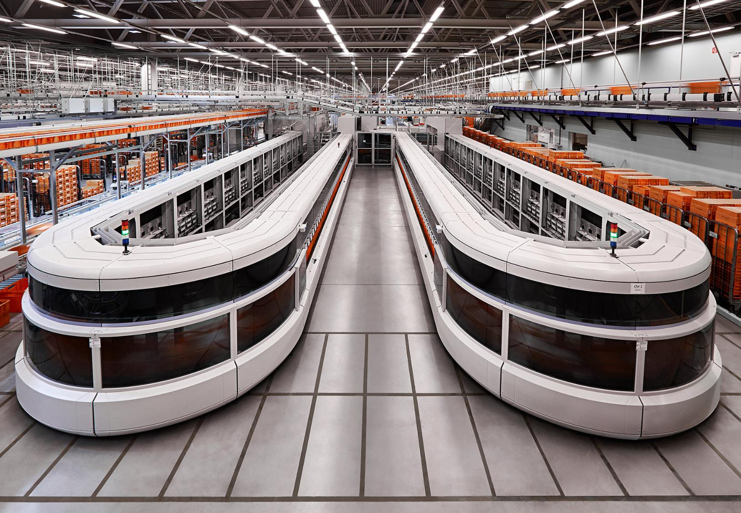

Serverless with R & Azure
Advanced Analytics@POST AG
Christoph Bodner & Thomas Laber

Slide 2

Agenda
O1
O2
O3
Topics
Who we are
(obligatory marketing stuff…)
Data Science@Post AG:
Overview: Post AG
Interdisciplinary team
Why serverless
Overview:
Pros and Cons
Popular platforms + frameworks
Serverless R in Azure
Lots of options for:
Batch processing
Realtime processing
Case Studies:
U-SQL
Azure Functions

Slide 3
Agenda
O1
O2
O3
Topics
Who we are
(obligatory marketing stuff…)
Data Science@Post AG:
Overview: Post AG
Interdisciplinary team
Why serverless
Overview:
Pros and Cons
Popular platforms + frameworks
Serverless R in Azure
Lots of options for:
Batch processing
Realtime processing
Case Studies:
U-SQL
Azure Functions

Slide 4
Overview: POST AG
Company Performance & Parcel Volumes Over time
Sales Performance
mio EUR
Parcel volumes of Austrian Post mio parcels
+2,3%
Ø +9%
2.030,5
1.895,6
1.938,9
+20%
+17,7%
-2,1%
Mail division
Parcel division
trans-o-flex (sold 2016)

Slide 5

















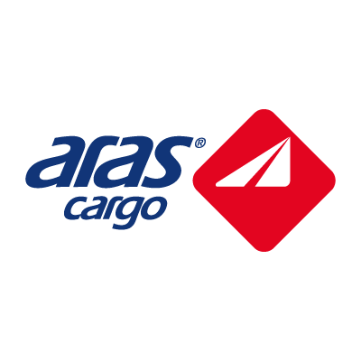
Overview: POST AG
Strong Presence in Eastern Europe
GROWTH FOCUS on Parcel & LOGISTICS Division
Thomas lives here
(Villach:)
I am from Lienz
Please pardon my accent☺
Notes:
5

Slide 6




Our Team
People Who like $πz^{2}a$ in every form
Christoph Bodner
Thomas Laber
Martin Blöschl
Raphael Pesl
Lead Data Scientist
Senior Data Scientist
Junior Data Scientist
Junior Data Scientist
Quantitative Finance (WU)
Prev.: KPMG
Business Informatics (TU)
Prev.: Accenture
Computational Intelligence (TU)
Mathematics (TU)

Slide 7
Agenda
O1
O2
O3
Topics
Who we are
(obligatory marketing stuff…)
Data Science@Post AG:
Overview: Post AG
Interdisciplinary team
Why serverless
Overview:
Pros and Cons
Popular platforms + frameworks
Serverless R in Azure
Lots of options for:
Batch processing
Realtime processing
Case Studies:
U-SQL
Azure Functions

Slide 8
Why serverless
Serverless has Servers, but we don‘t have to care ☺
Just like wireless internet has wires somewhere, serverless architectures still have servers somewhere. What ‘serverless’ really means is that, as a developer you don’t have to think about those servers. You just focus on code.
serverless.com

Slide 9




Why serverless
The Promise: Focus on Coding, not maintenance
No administration
Scale on demand
Pay-per-use
Faster turnaround
No server provisioning and maintenance is necessary. Hardware and OS are abstracted away
Scaling is automatic and part of the service.
Billing is based on actual compute resources used. No compute used, no costs.
No server provisioning and maintenance is necessary. Hardware and OS are abstracted away

Slide 10








Why serverless
Serverless Data Science Architecture
docker pull
Batch Training
Pool 1
Pool 2
…
get training data
Pool n
store models
Model storage
get scoring data
Project 1
Project 2
…
Project n
write results
read models
Auto-Scaling
Trigger
REST
Batch Scoring
Realtime Scoring

Slide 11







Why serverless
Pros & Cons of going Serverless
PROs
CONs
No maintenance of
OS or hardware
Potential vendor
lock-in
Focus on coding
Durable/long-running
Functions?
Fast iterations from
Dev to Prod
Limited control env.
(depending on service)
Auto-Scaling easy
(depending on service)
Efficient usage of
resources

Slide 12







Why serverless
Popular Platforms and Frameworks
Overview Function Platforms
Cloud agnostic
serverless framework
Fixed runtimes
v2
You can also create a functions runtime on
Kubernetes with Kubeless
Docker runtime

Slide 13
Agenda
O1
O2
O3
Topics
Who we are
(obligatory marketing stuff…)
Data Science@Post AG:
Overview: Post AG
Interdisciplinary team
Serverless – Why care?
Overview:
Pros and Cons
Popular platforms + frameworks
Serverless R in Azure
Lots of options for:
Batch processing
Realtime processing
Case Studies:
U-SQL
Azure Functions

Slide 14
Serverless R in Azure
Overview ServerLess Services for R
Quite a lot of different serverless services …
… R support/integration varies a lot
Azure ML
Azure Functions (v1 and v2)
Azure Container Instances + Logic Apps
U-SQL
AzureBatch
Azure ML has drag & drop, but old runtime (R 3.1.1)
Azure Functions v1 can support R with site extension, v2 can support it natively in theory
ACI is Docker-as-a-Service, so it supports R fully + graphical workflows (Logic Apps)
U-SQL allows to integrate R 3.2.2 into Map-Reduce piplelines
AzureBatch supports arbitrary runtimes

Slide 15
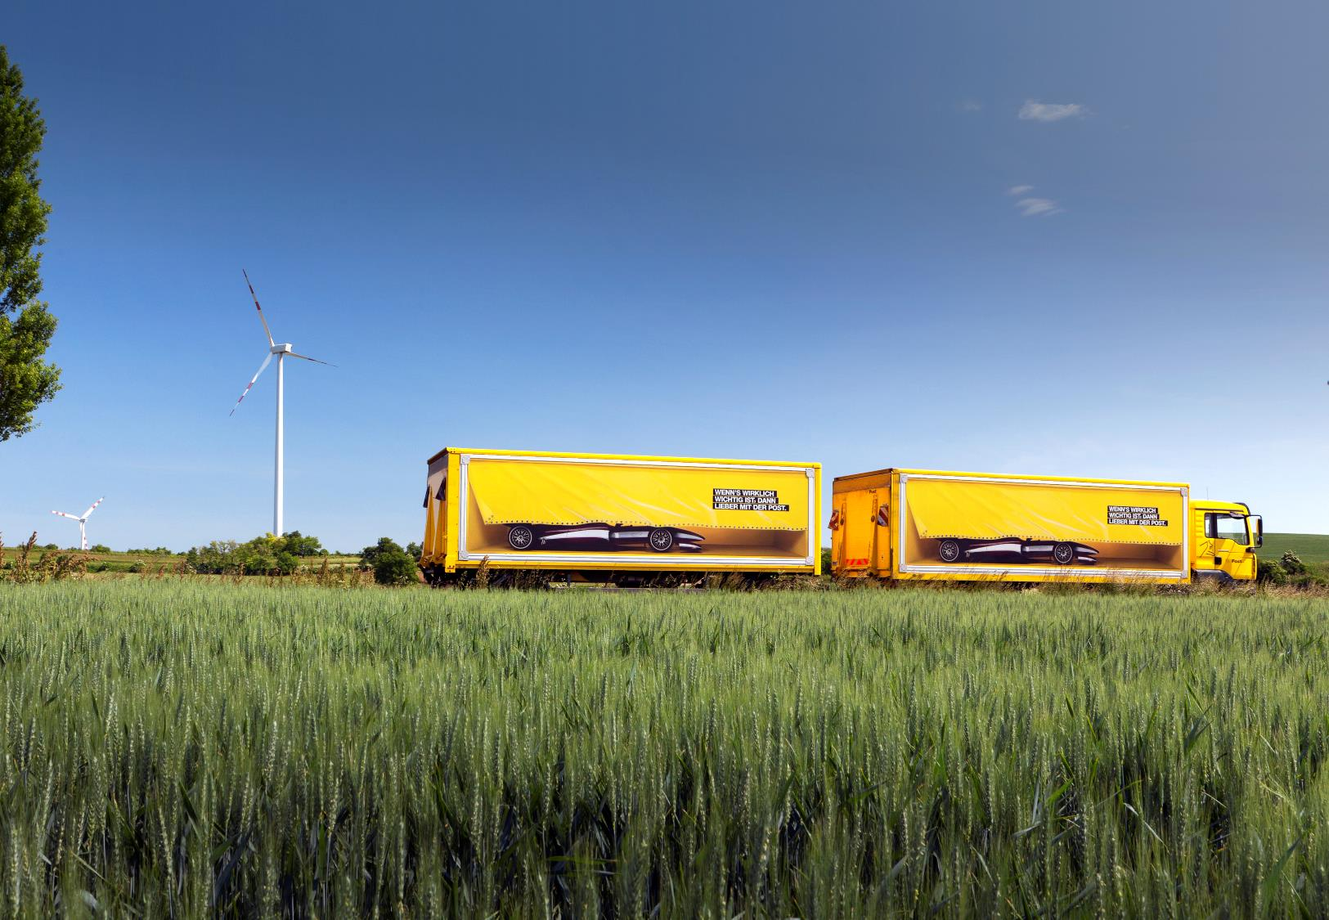
CASE sTUDY
Realtime
Azure Functions

Slide 16
Azure Functions
Overview
Tech specs
Integrating R
Two different runtimes:
Version 1 and Version 2
v2 is written in .net core and is therefore cross plattform + supports custom linux container
v2 currently supports no consumption plan
v2 supports arbitrary Linux Docker container
Version 1:
Call R site-extension with Powershell/Python/C# etc
Consumption plan possible
Very easy to implement
Version 2:
Implementation of arbitrary language workers, so R can be a first-class Azure function citizen☺
Alternatively, call R from C#/F# etc.
Interested in helping?

Slide 17
Azure Functions
Demo
Let’s do a quick
Demo!

Slide 18
CASE sTUDY
baTCH
U-sql
Notes:
https://docs.microsoft.com/en-us/azure/data-lake-analytics/data-lake-analytics-u-sql-r-extensions
https://docs.microsoft.com/en-us/azure/data-lake-analytics/data-lake-analytics-u-sql-develop-with-python-r-csharp-in-vscode
https://docs.microsoft.com/en-us/azure/data-lake-analytics/data-lake-analytics-u-sql-get-started

Slide 19
U-SQL
Demo
Let’s do a quick
Demo!

Slide 20
Thank you for
your attention!
Any questions?
You can contact us at:
christoph.bodner@post.at
thomas.laber@post.at

Slide 21
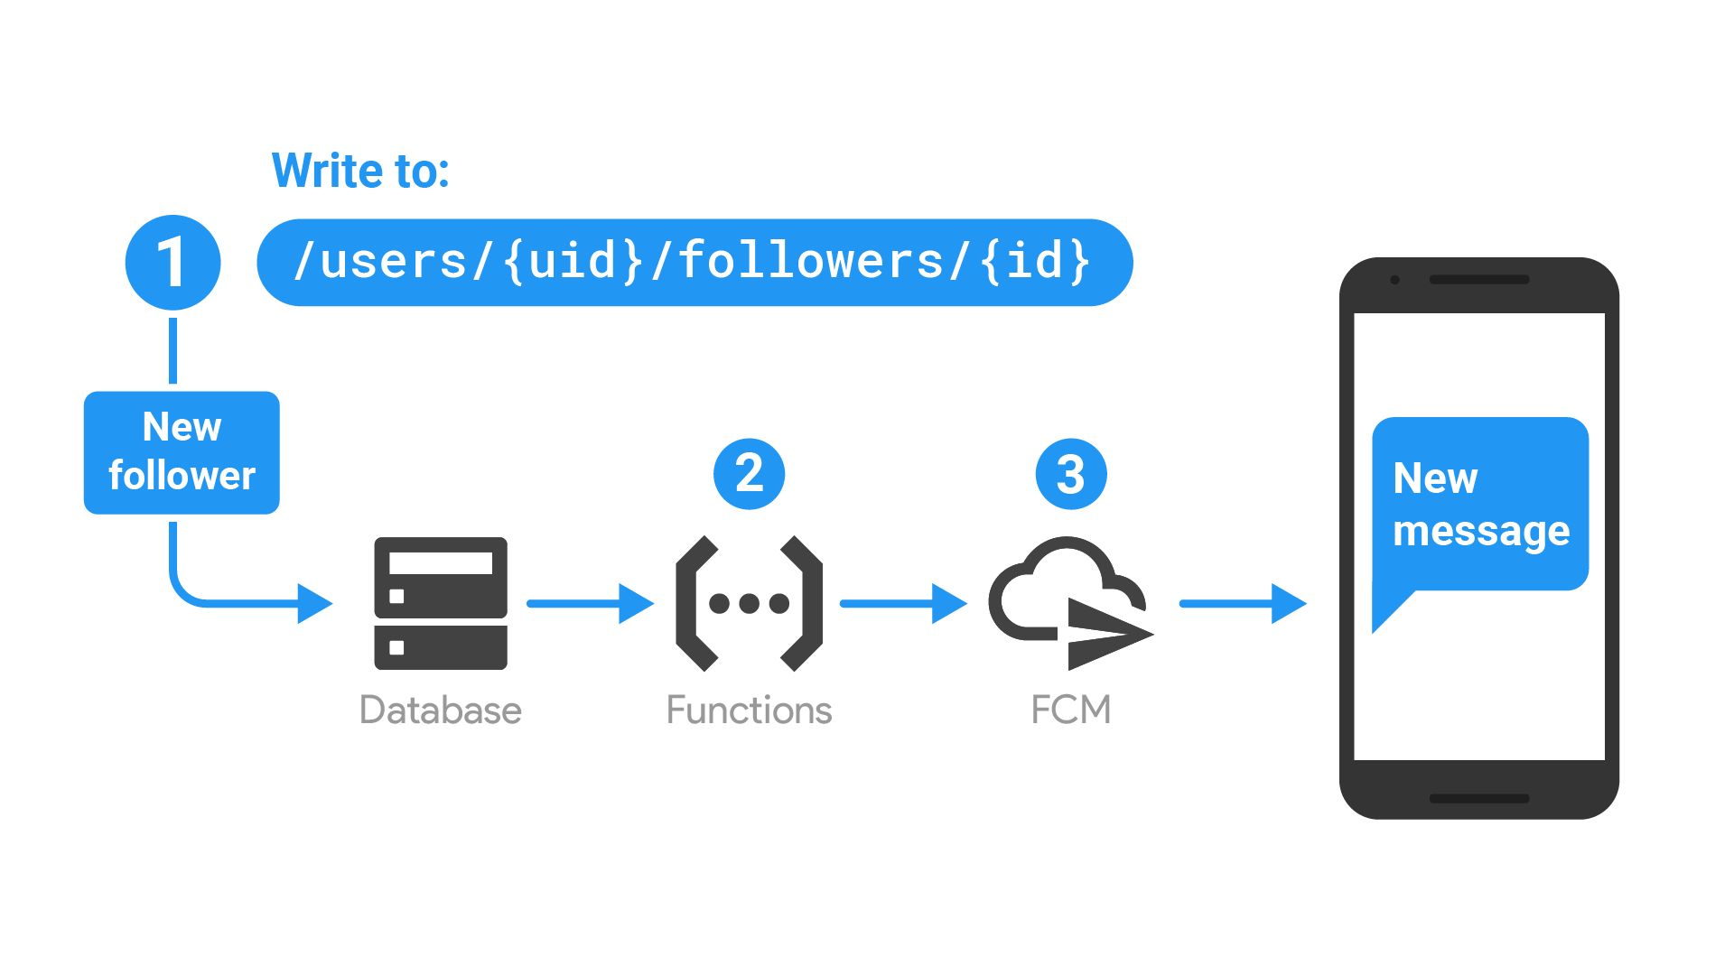
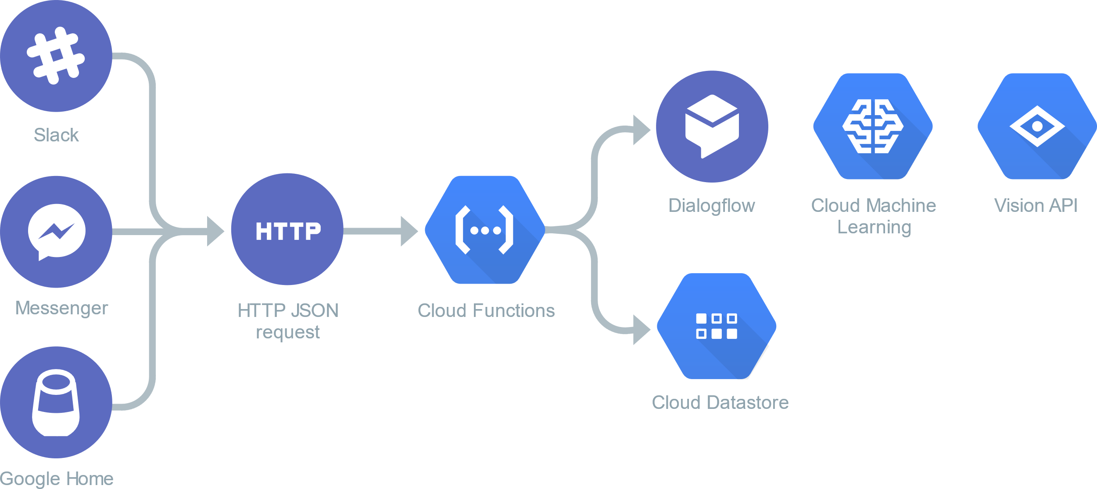



Why serverless
Serverless Data Science Architecture
docker pull
Get training
data
Batch Training
Pool 1
Pool n
Store models
Get scoring
data
Model storage
Project 1
Project 2
…
Project n
Read models
Redesign like flow chart below!
Write results
Auto scaling
Batch Scoring
Realtime Scoring
Trigger
REST

